Slide 1
Work Status
Weekly Update - 05-20-20

Slide 2
Weekly Update
In detail examination
RB - Normalized
WS - Normalized
Linear Modeling
RB
WS
Normalization method change
Prior Scenario:
raw level normalization + log transformation
Present Scenario:
raw level log transformation + mean level normalization

Slide 3
Logarithmic Transformation - Plots

Slide 4
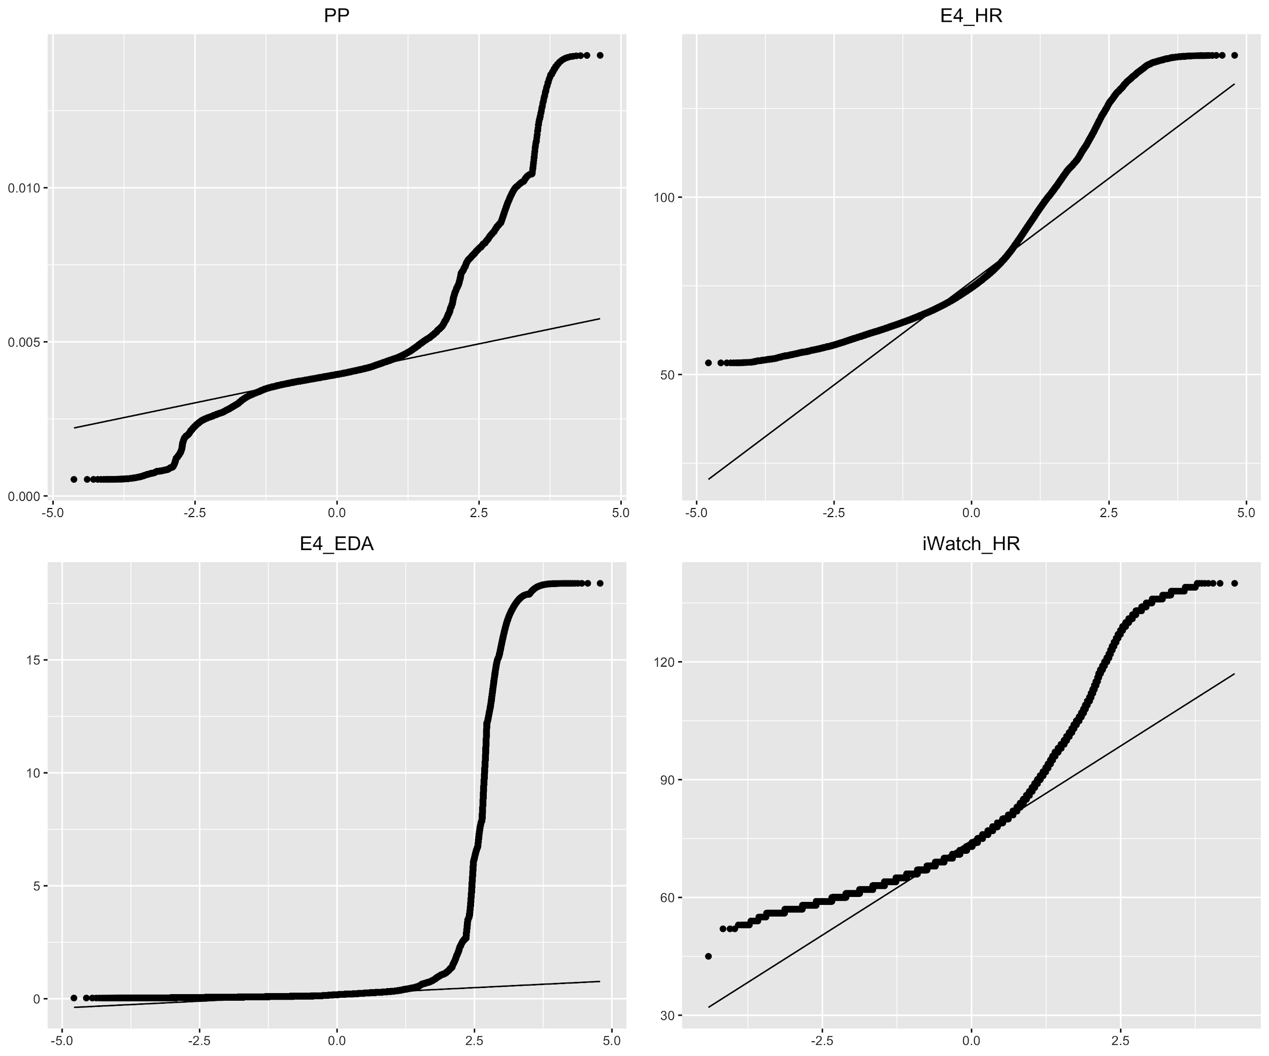
QQ Plot - Before Log transformation

Slide 5
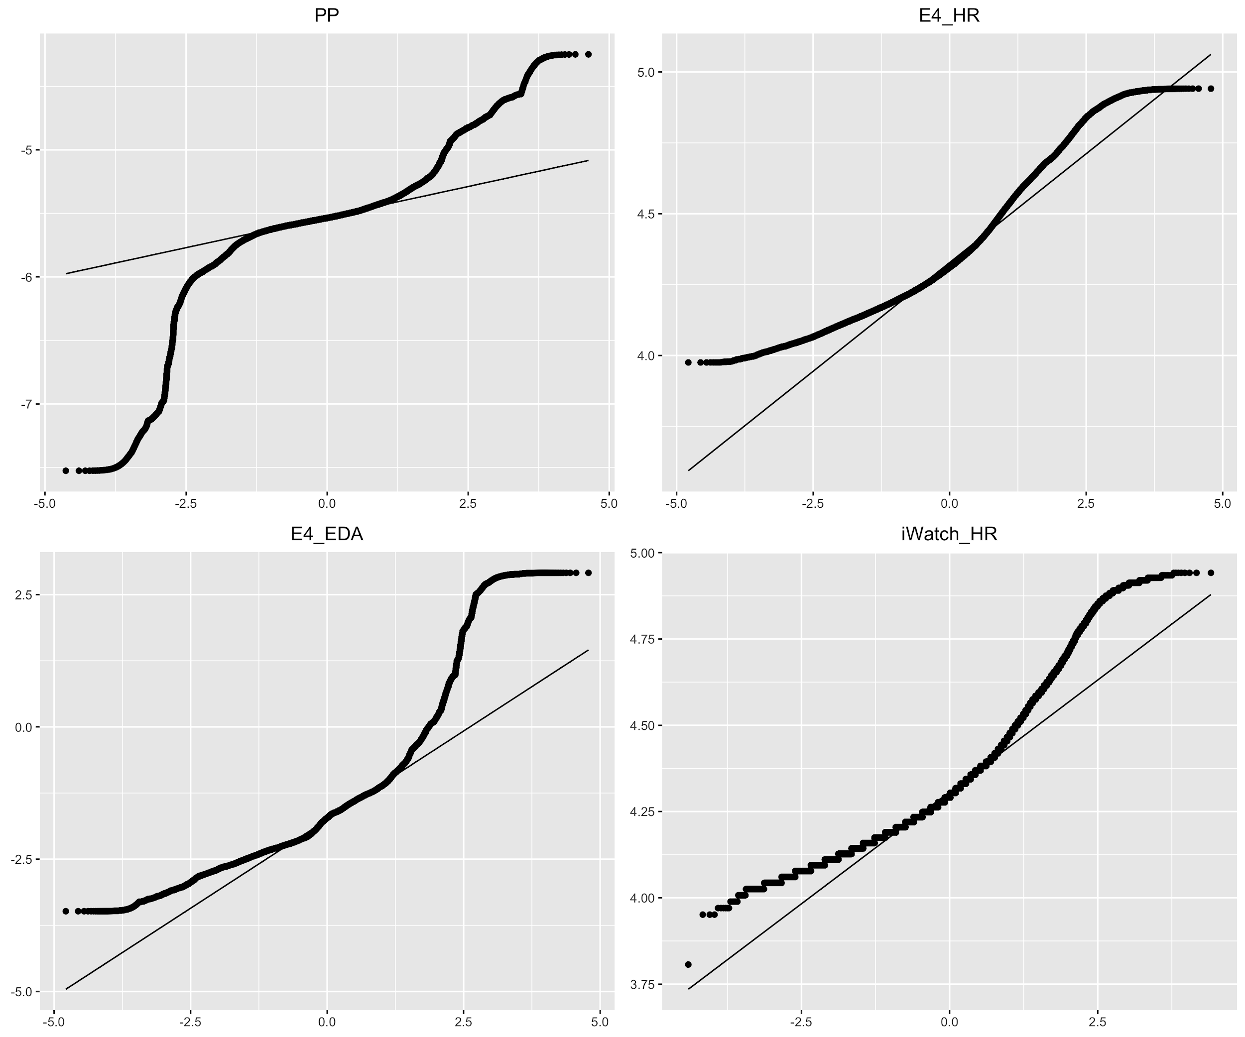
QQ Plot - After Log transformation

Slide 6
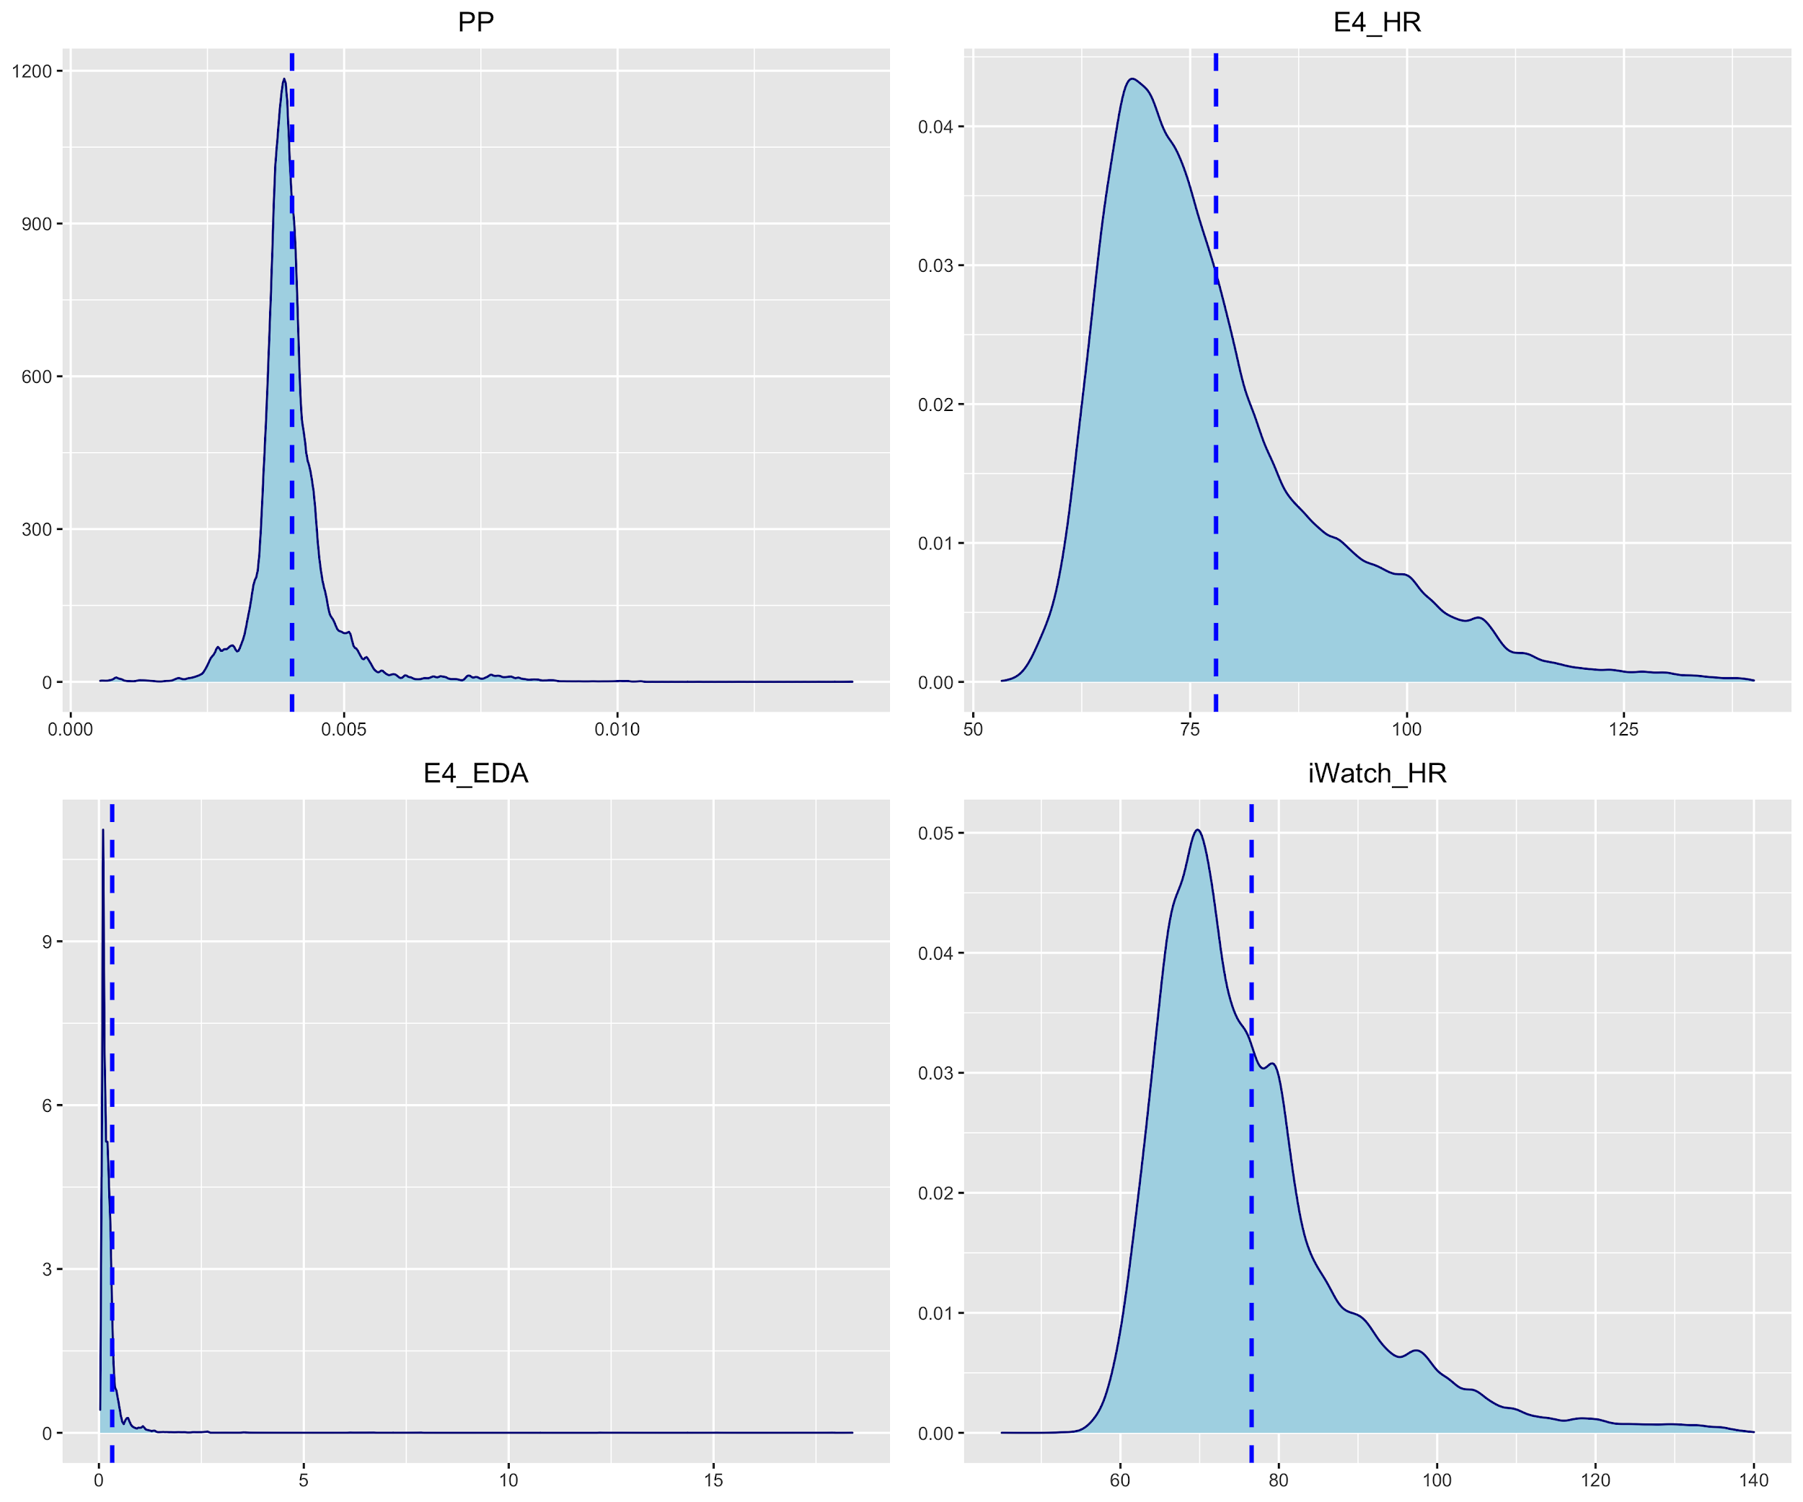
Distribution Plot - Before Log transformation

Slide 7
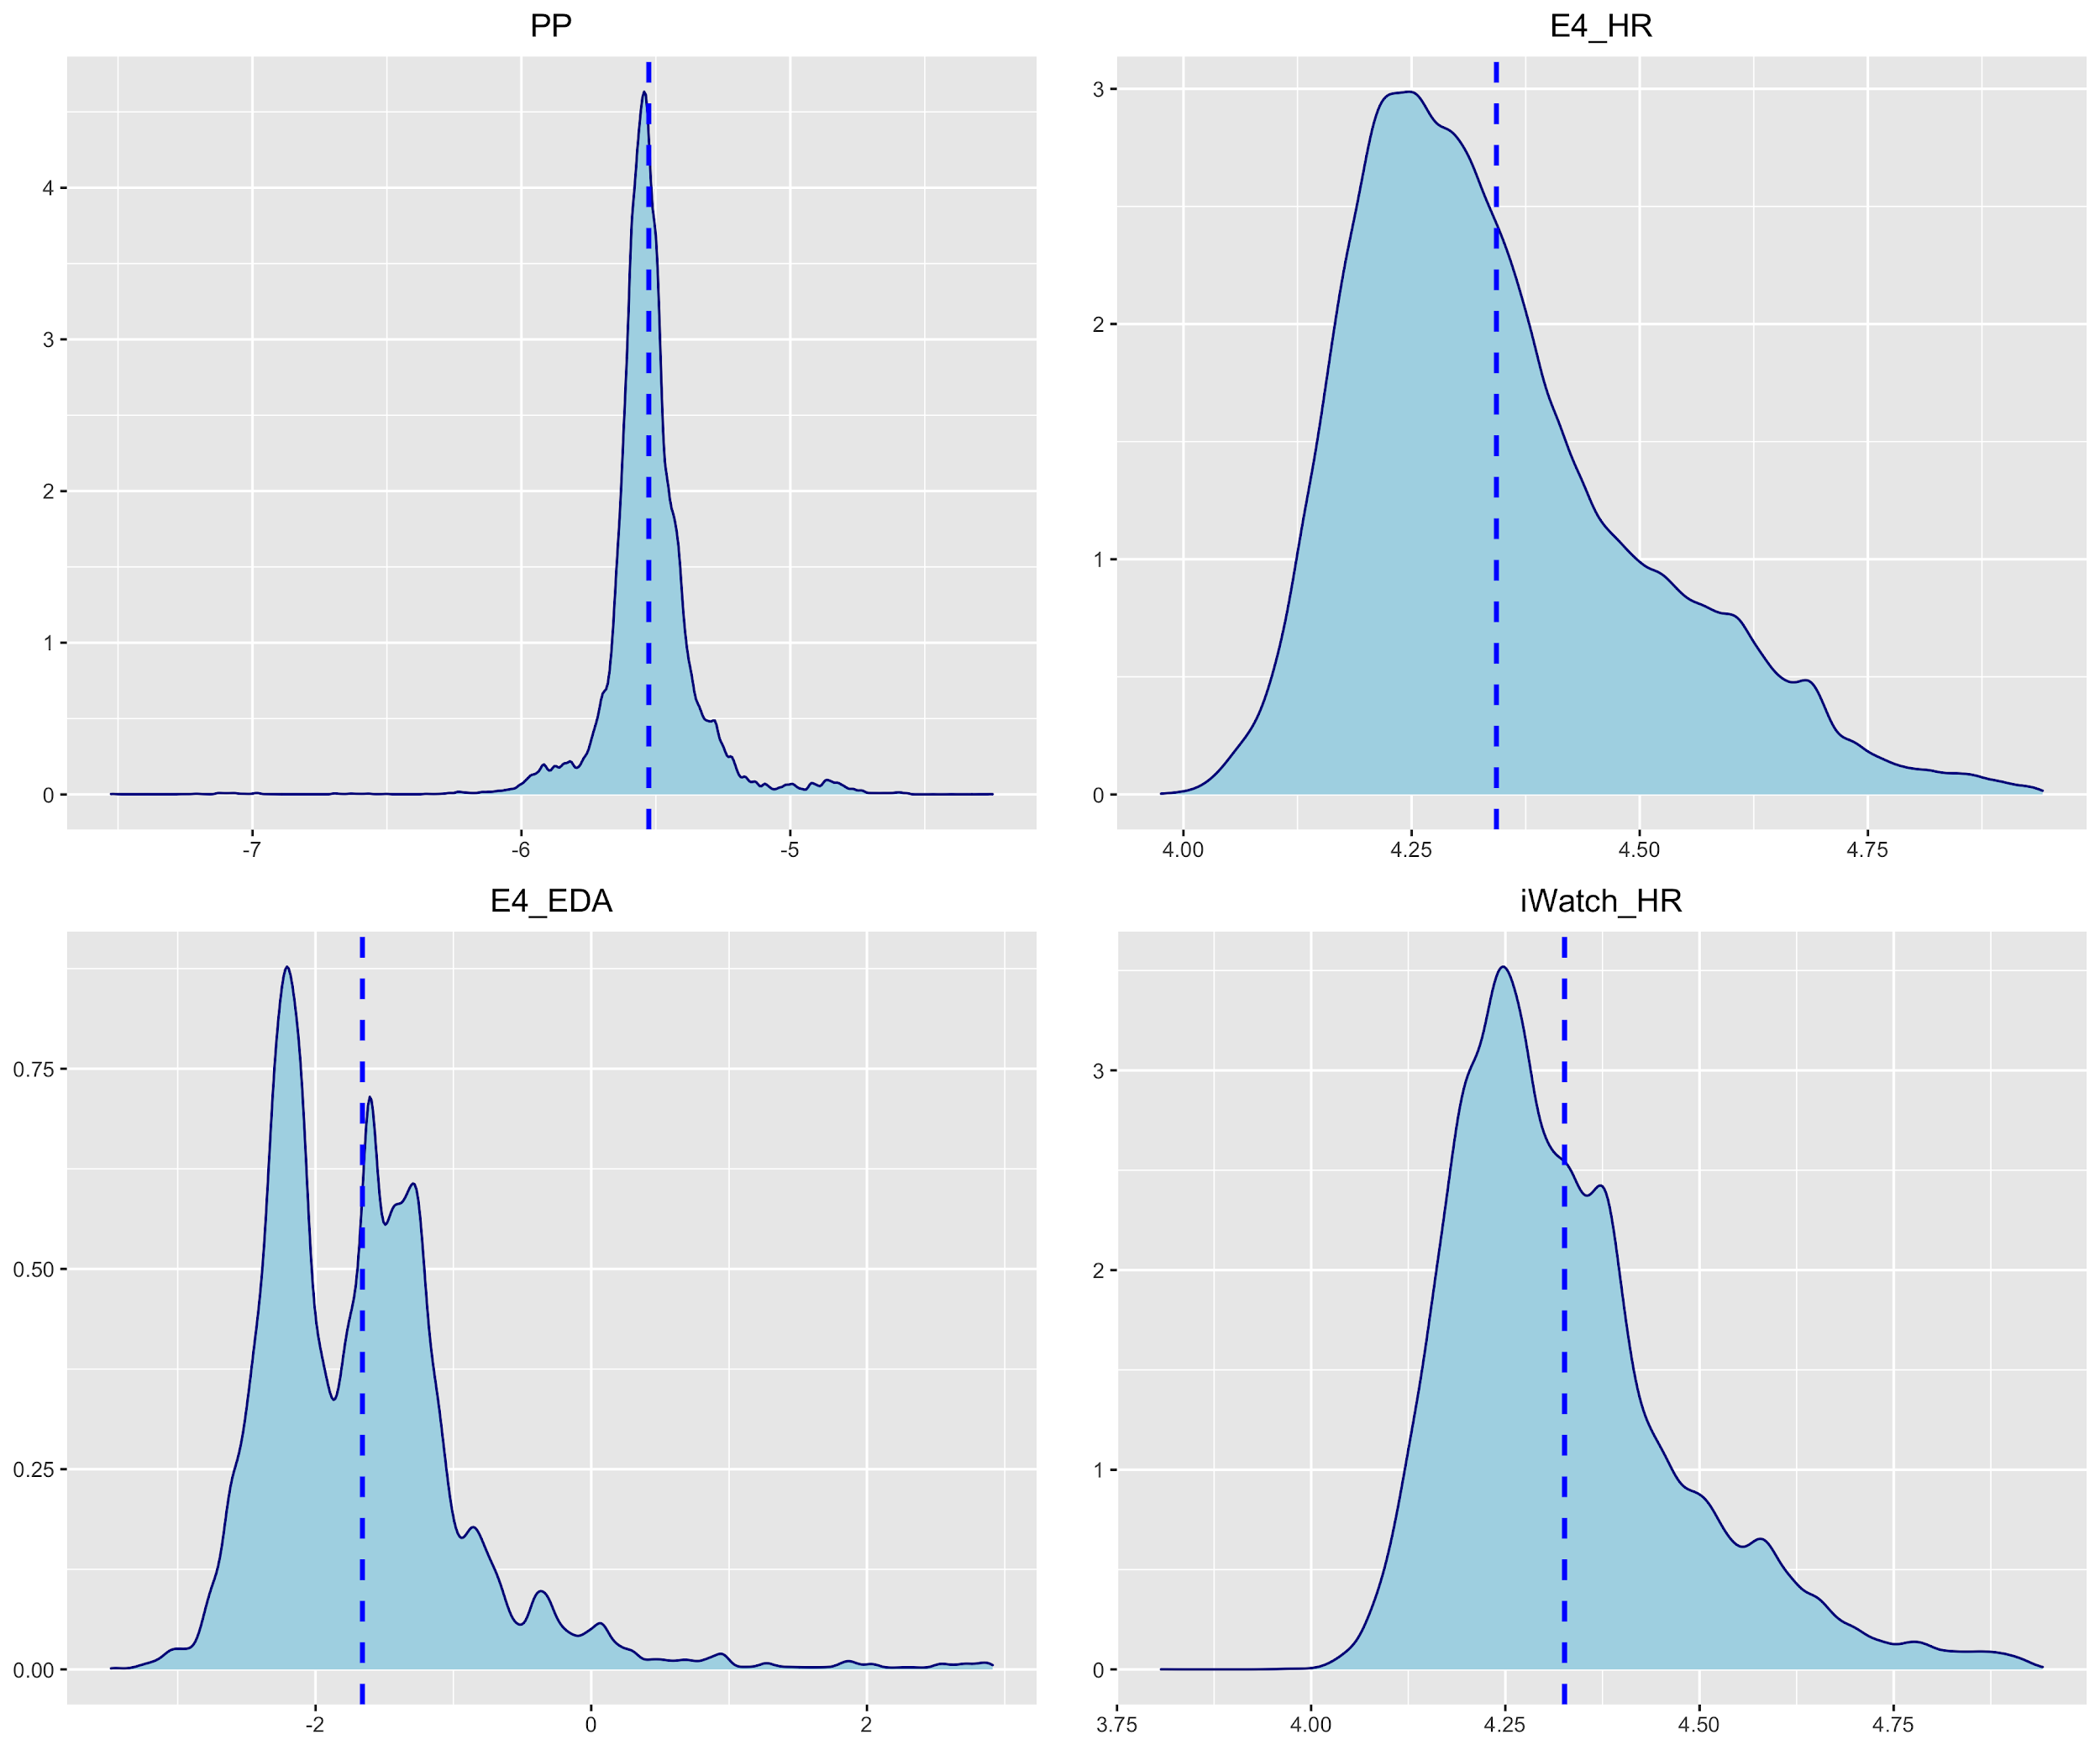
Distribution Plot - After Log transformation

Slide 8
In detail examination - Deadline effect

Slide 9
In detail examination - Resting Baseline - Raw
\bar{ RB_Si} - mean(\bar{ RB_Si_D3} , \bar{ RB_Si_D4})

Slide 10
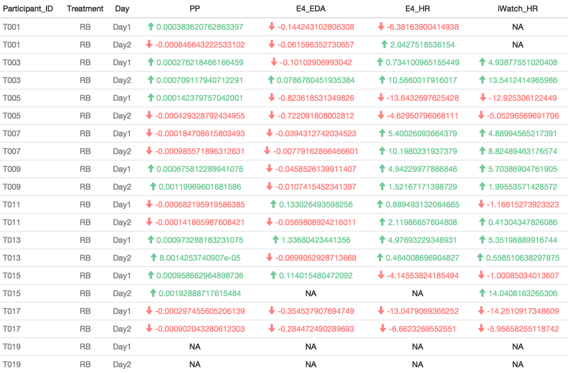
In detail examination - Resting Baseline - Raw

Slide 11
In detail examination - Resting Baseline - Normalized
delta = abs(min(RB))+ 0.01
\bar{ ln( RB_Si) + delta } - mean(\bar{ RB_Si_D3 + delta} , \bar{ RB_Si_D4 + delta})

Slide 12
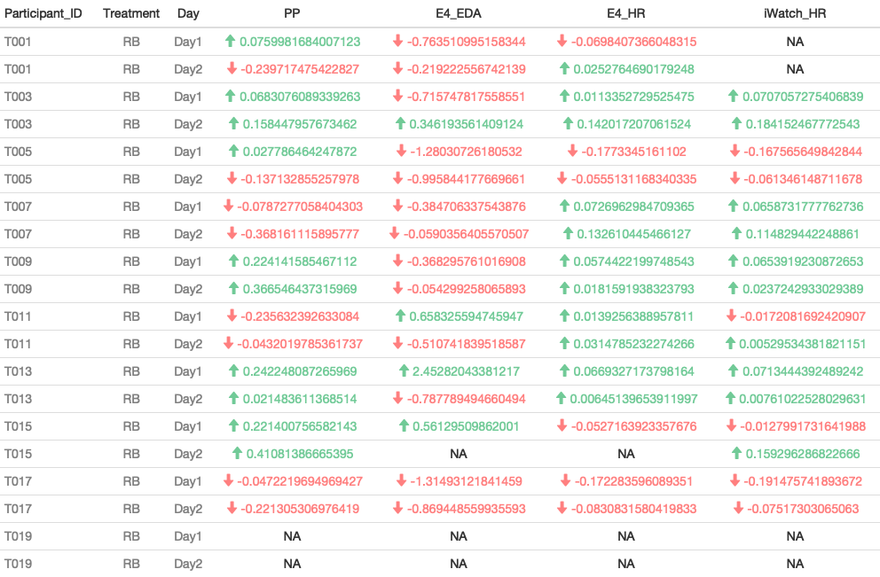
In detail examination - Resting Baseline - Normalized

Slide 13
In detail examination - Resting Baseline - Normalized
Dj_rb = \bar{ln(RB_Si_Dj)}
Dj_rb - mean(D3_rb - D4_rb)

Slide 14
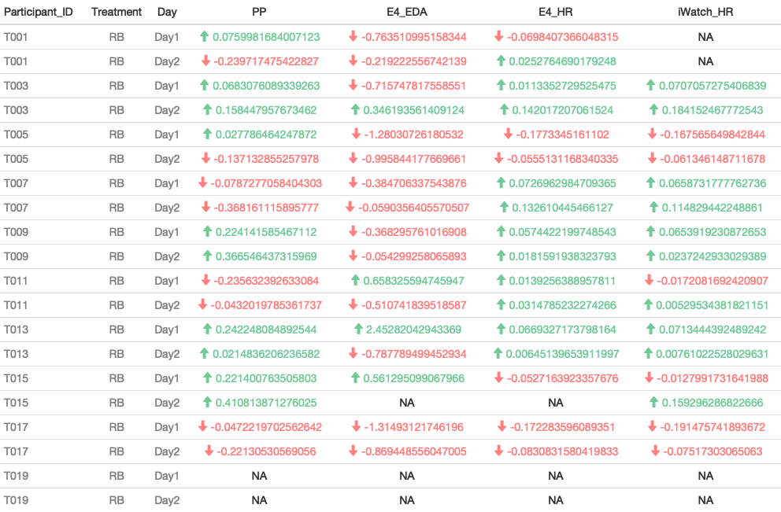
In detail examination - Resting Baseline - Normalized

Slide 15
In detail examination - Resting Baseline - Normalized
T003, T009, T013 → Surely has serious deadline
T015 → Follows the deadline pattern

Slide 16
In detail examination - Working Session - Normalized
Day1 and Day2
delta = abs(min(RB))+ 0.01
Dj_mean= \bar{ ln( WS_Si_Dj - \bar(RB_Si) + delta)}
Day_j = Dj_mean - mean(D3_mean - D4_mean)

Slide 17
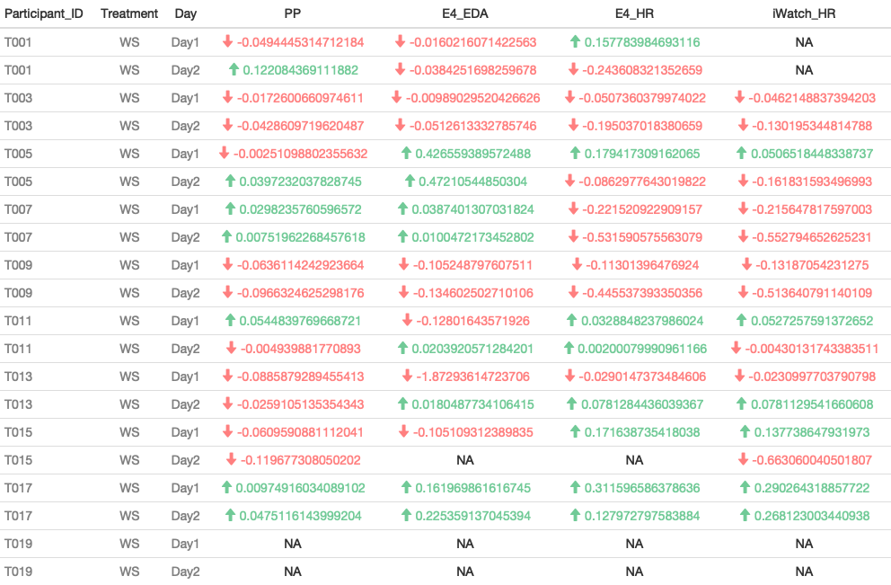
In detail examination - Working Session - Normalized

Slide 18
In detail examination - Working Session - Normalized
Dj_ws = \bar{ln(WS_Si_Dj)}
Dj_ws - mean(D3_ws - D4_ws)

Slide 19
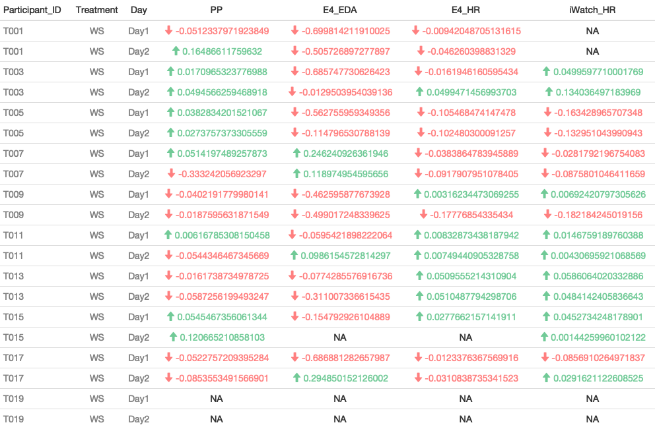
In detail examination - Working Session - Normalized

Slide 20
Linear Modeling - Resting Baseline

Slide 21
Linear Modeling - Resting Baseline
delta = abs(min(RB))+ 0.01
\bar{ ln( RB_Si) + delta }

Slide 22
Linear Modeling - Resting Baseline
Dj_rb = \bar{ln(RB_Si_Dj)}

Slide 23
Linear Modeling - Working Session
delta = abs(min(RB))+ 0.01
\bar{ ln( WS_Si_Dj - \bar(RB_Si) + delta)}

Slide 24
Linear Modeling - Working Session
\bar{ln(WS_Si_Dj)} - \bar{ln(RB_Si_Dj)}

Slide 25
Validation Plots

Slide 26
Validation Plots
Dj_ws = \bar{ln(WS_Si_Dj)}
Dj_ws - mean(D3_ws - D4_ws)

Slide 27
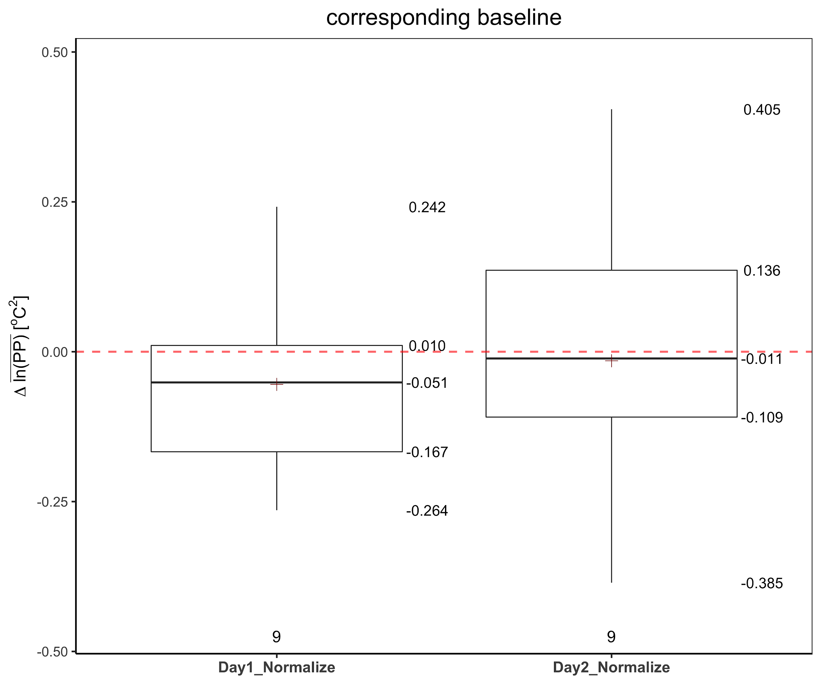
PP

Slide 28
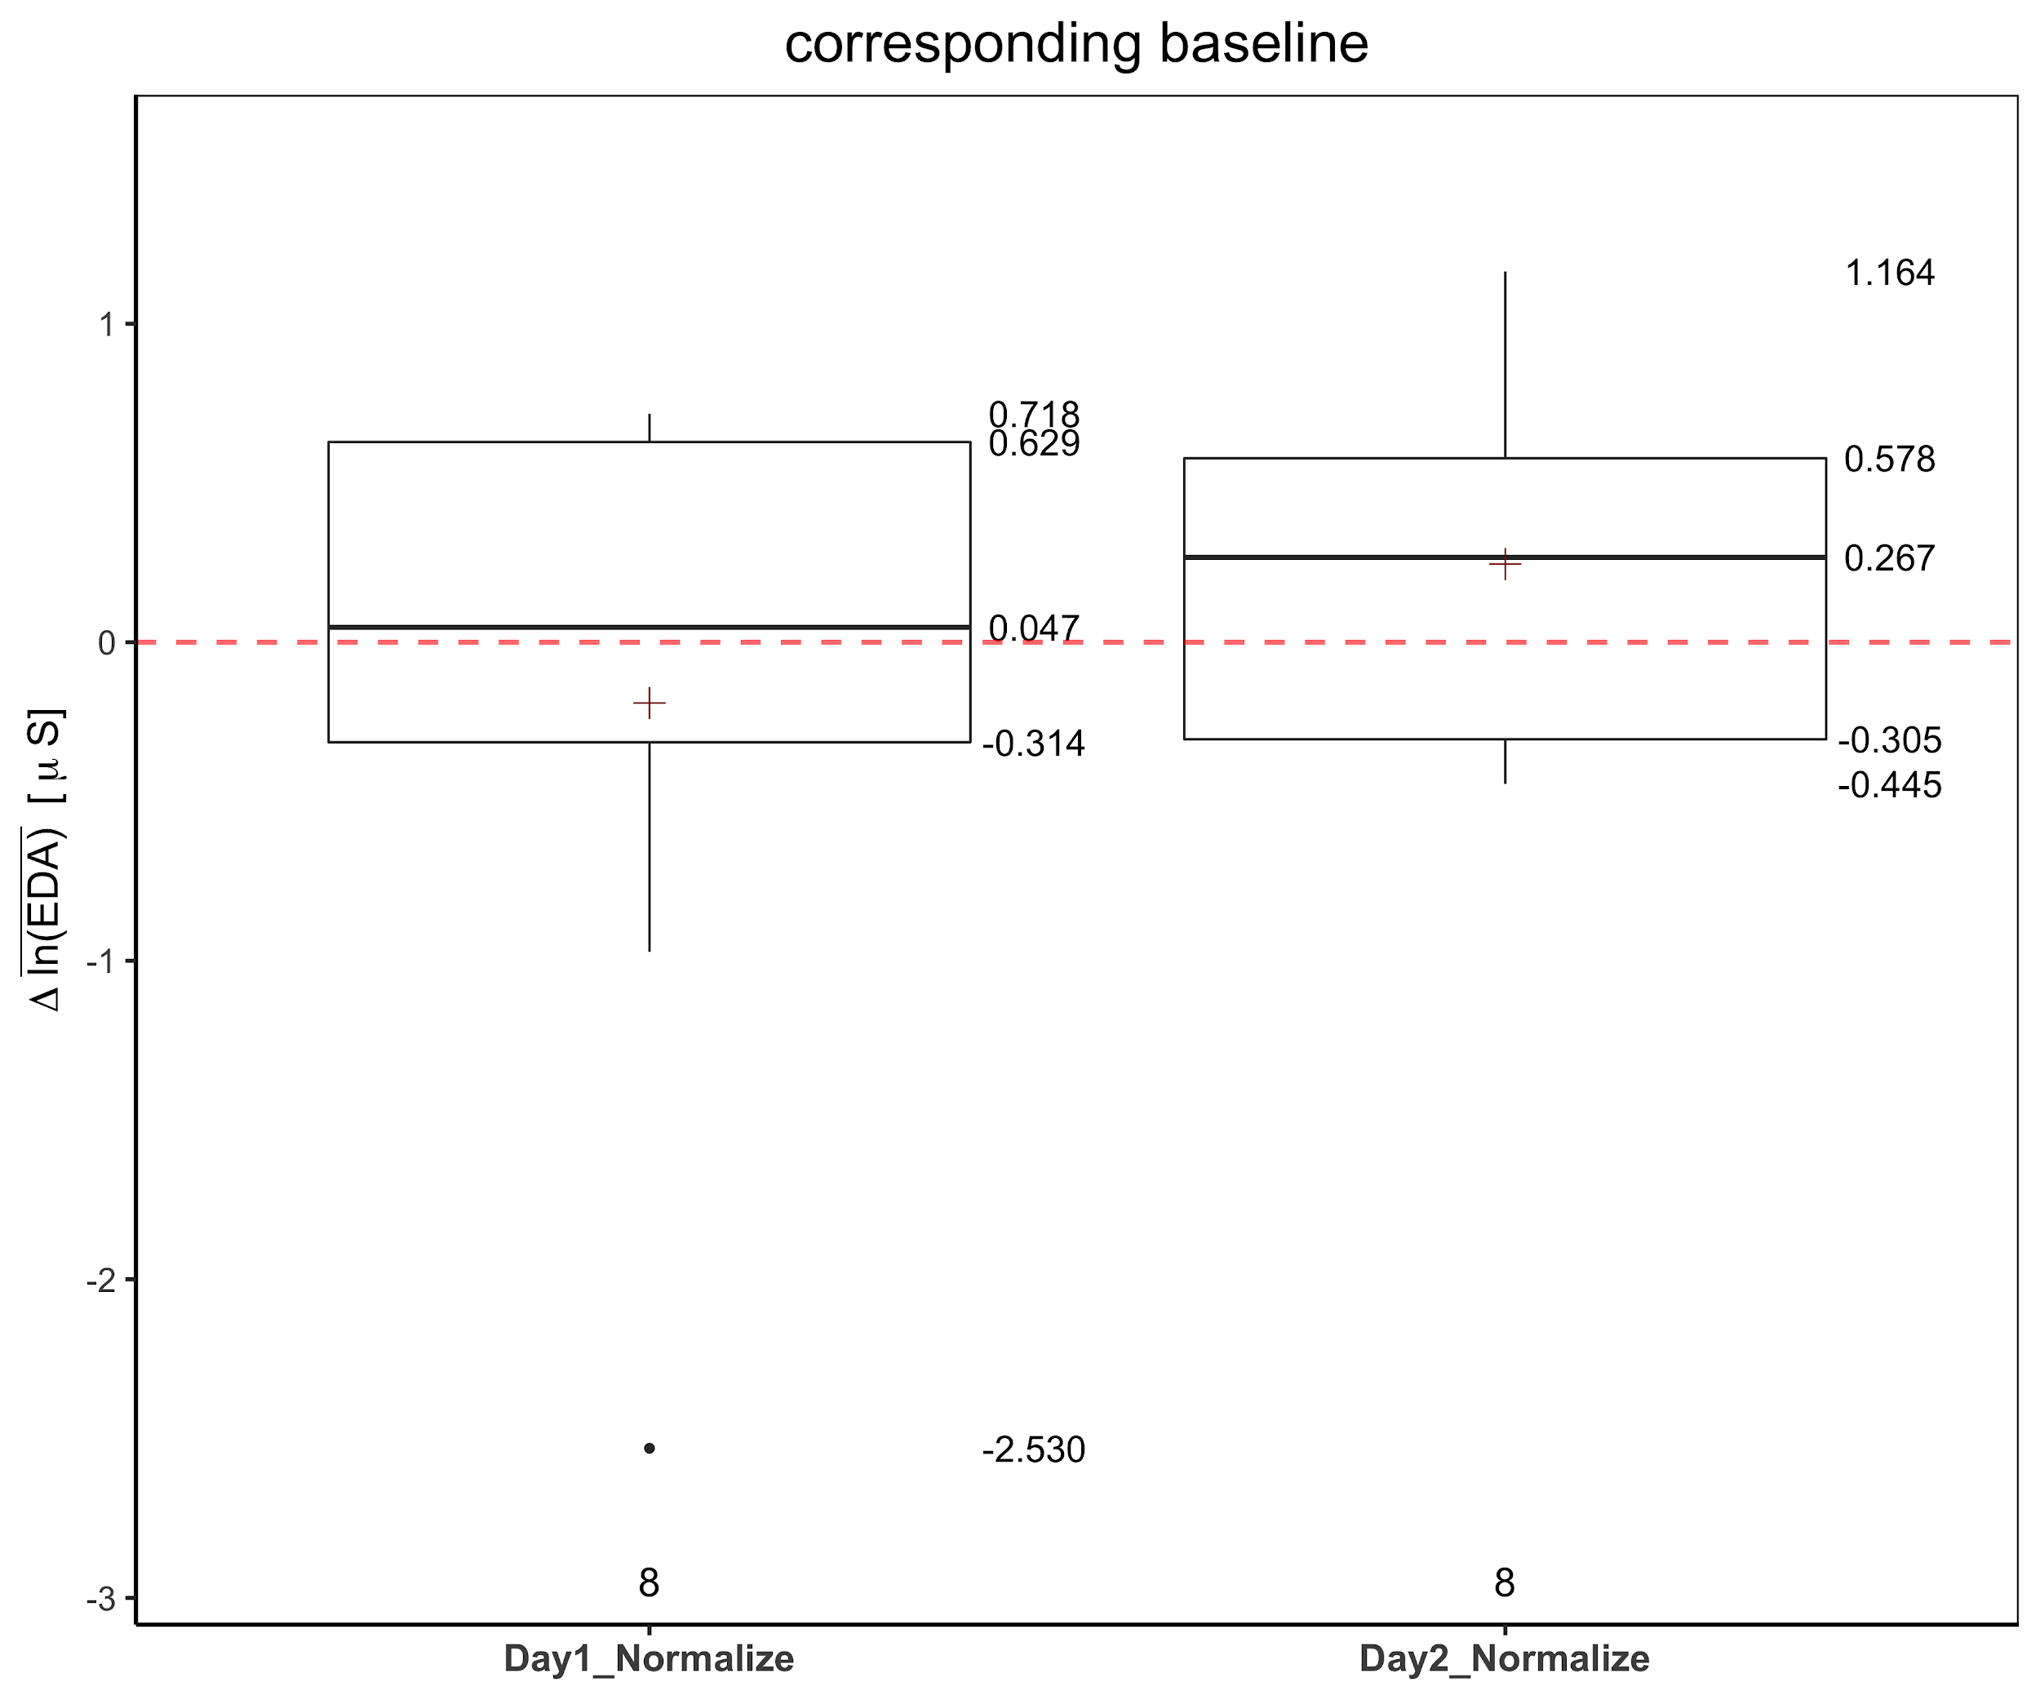
E4 EDA

Slide 29
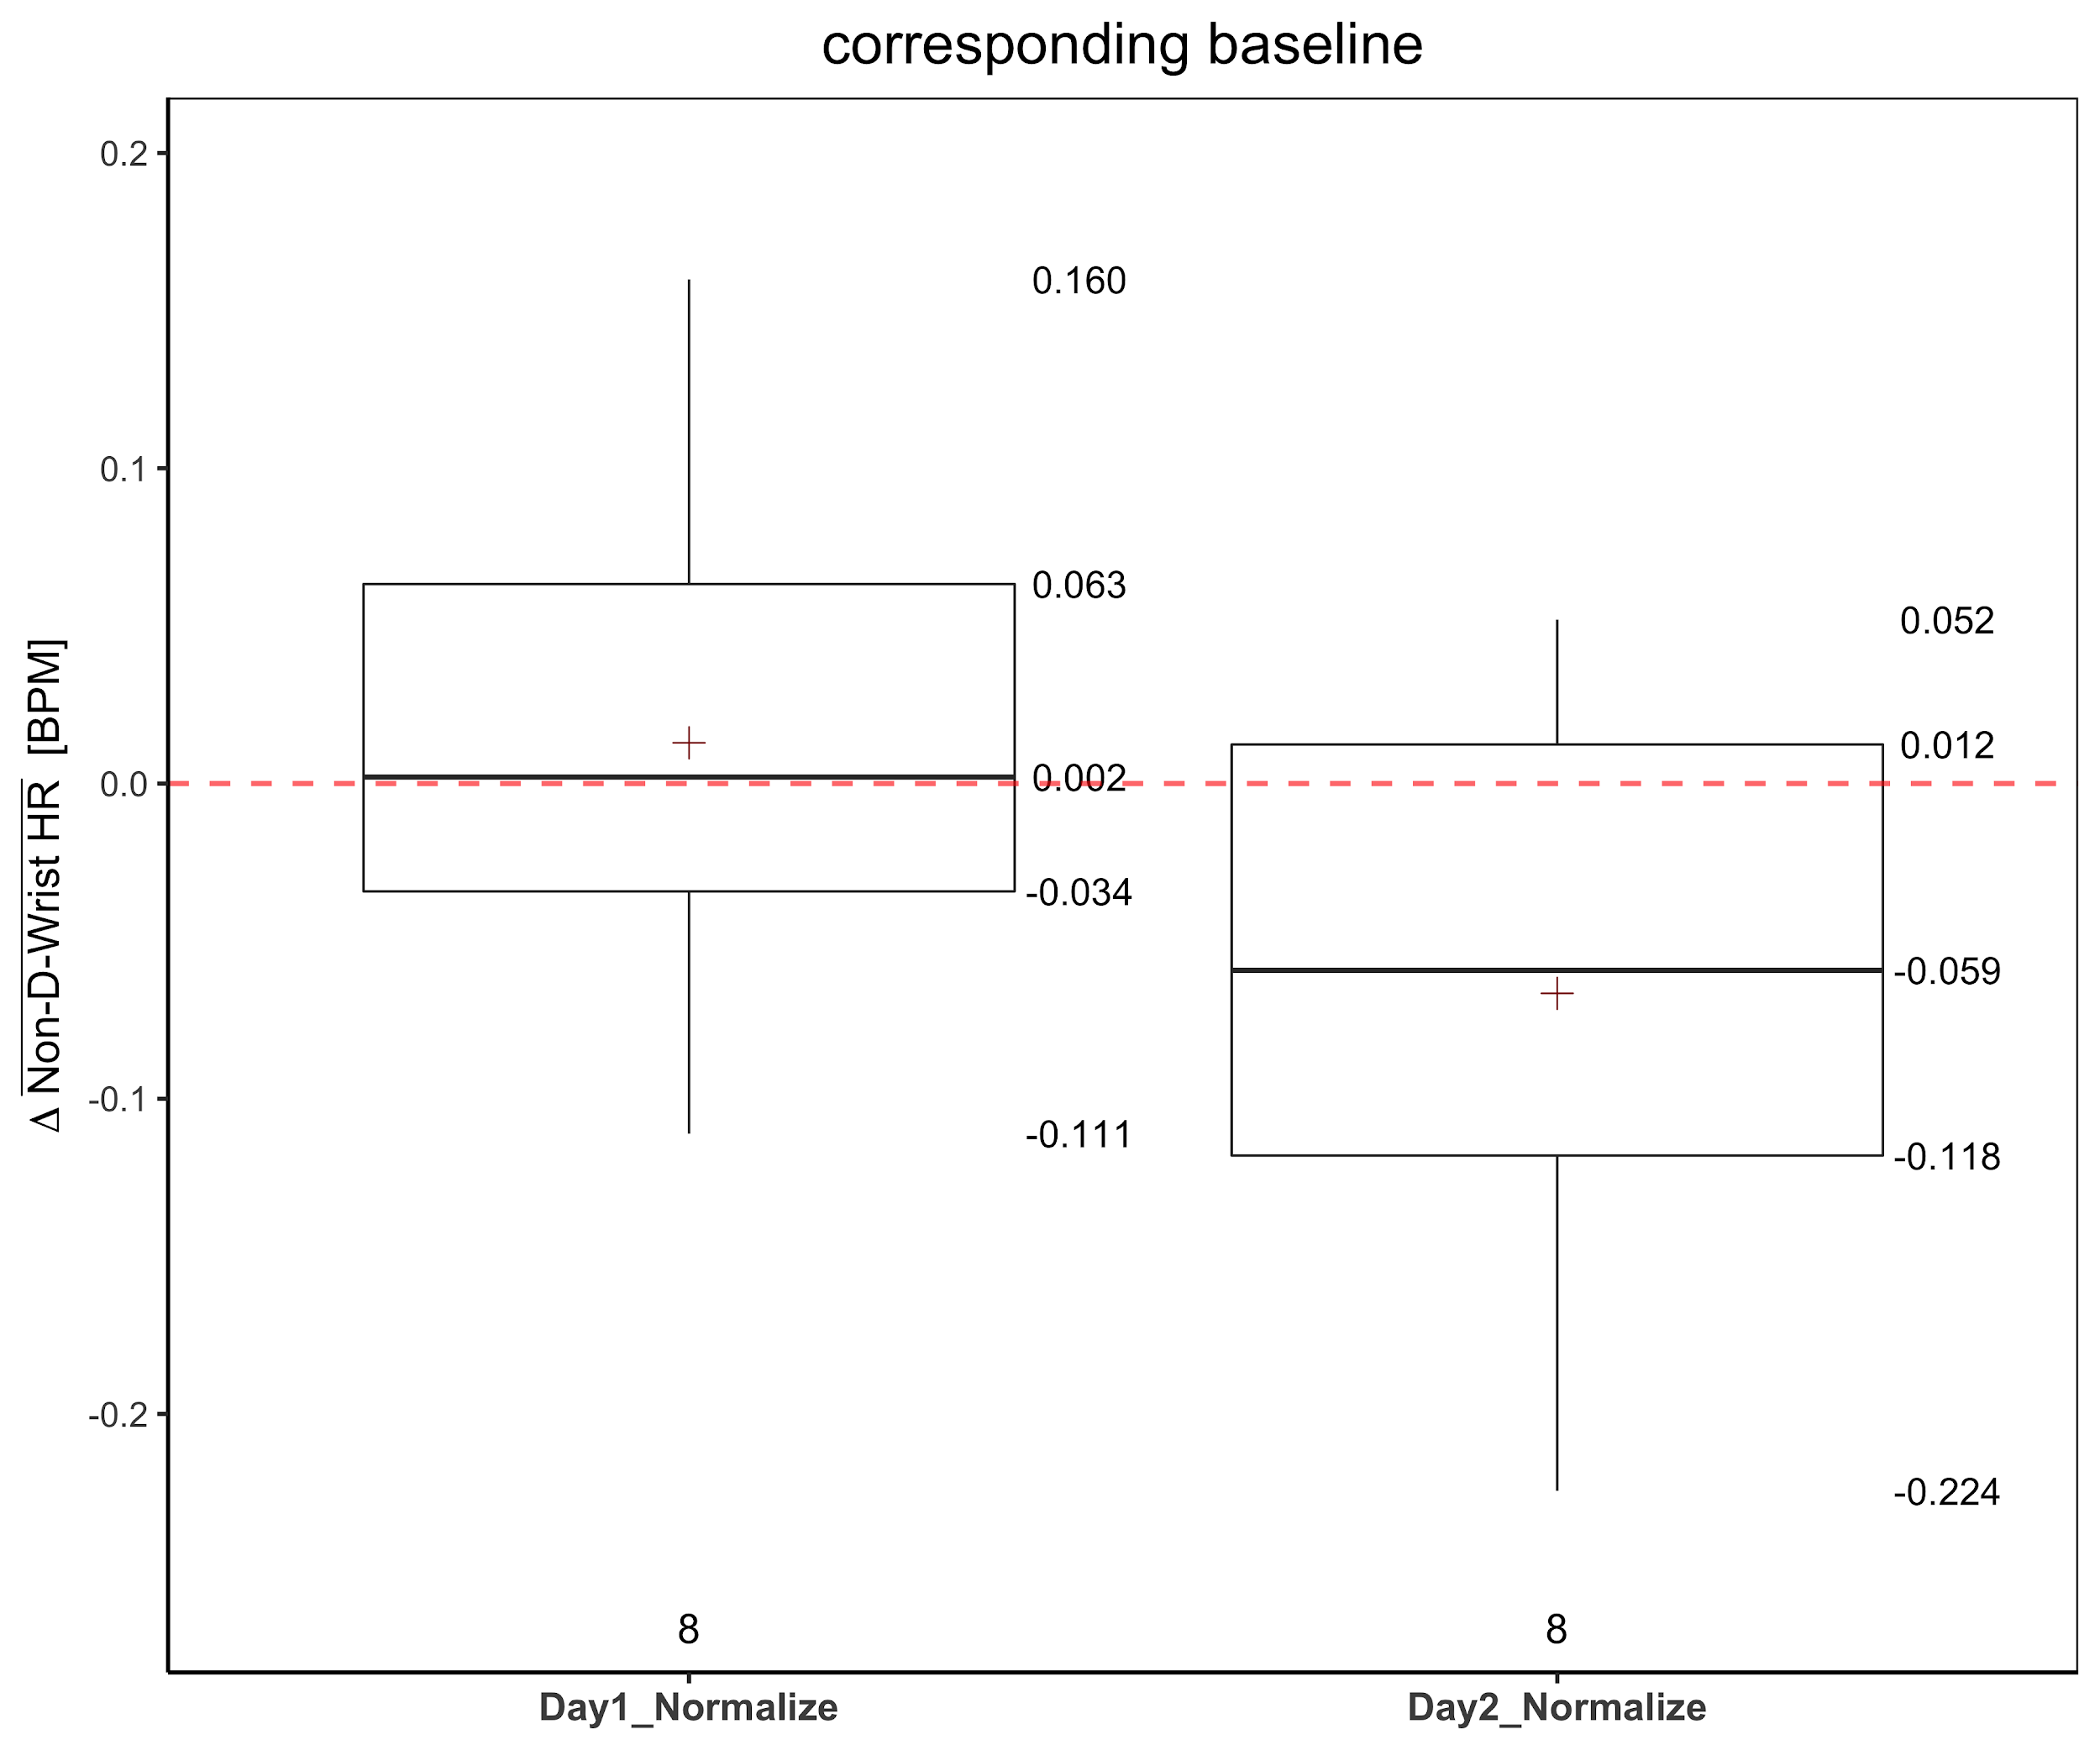
E4 HR

Slide 30
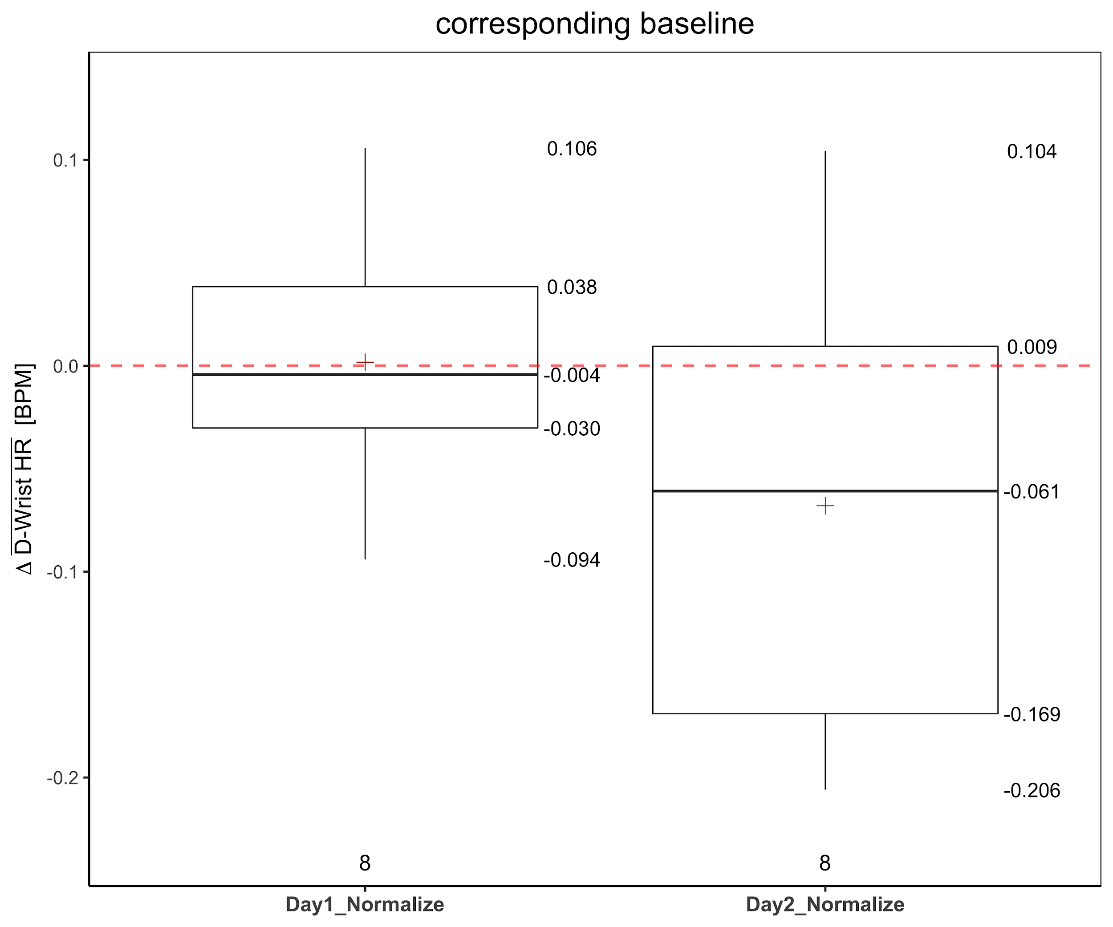
iWatch HR

Slide 31
Thank you

